Slide 1
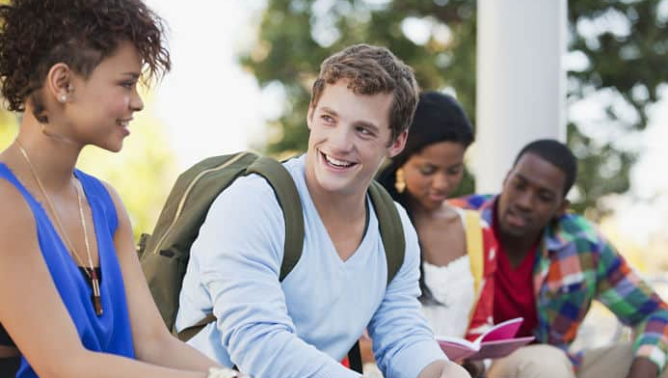
how often do you meet new people?
What are the first words you say to someone you are meeting for the first time?

Slide 2
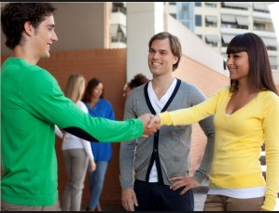
What is happening here?

Slide 3
Hello, I am Craig and this is my friend Mark
Hi Craig! I’m Anna and they are my roommates Laura and Joseph.

Slide 4
am
I
He
She
It
We
They
is
is
is
are
are

Slide 5
Am / æm /
Is / ɪz /
Are /ɑr /

Slide 6
I’m a good student
She’s my best friend
He’s my father
It’s raining heavily
We’re very happy
They’re really pretty

Slide 7
Can you introduce yourself?
Can you introduce your two best friends?

